Slide 1
HTML FORMS AND VALIDATION
Notes:
Copyright © Terry Felke-Morris

Slide 2

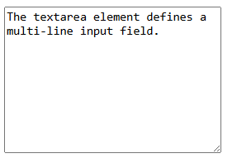
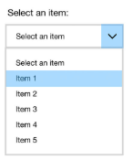
HTML FORM ELEMENTS
Label
Textfield/input
Textarea
Button
Select (drop-down list)
Checkbox and Radio buttons

Slide 3
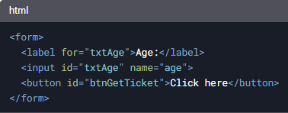
HTML FORM STRUCTURE
Forms are wrapped in <form> tags
Example:
Use of name attribute for server-side processing
The name attribute labels the text box – providing context for what value it contains.

Slide 4
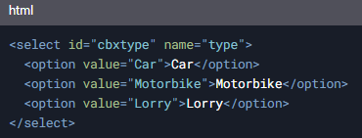

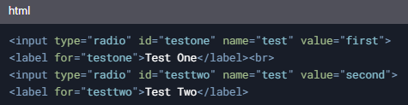


OTHER FORM ELEMENTS
Dropdown boxes (<select> and <option>)
Radio buttons
Checkboxes

Slide 5


Built-in HTML5 Validation
Use type attribute for basic validation:
required attribute prevents form submission if empty:

Slide 6
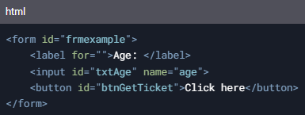
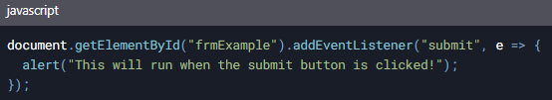

JavaScript Validation
JavaScript is still crucial for form validation
Example of adding a submit event listener:
Accessing form values:

Slide 7
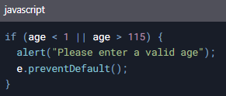
Preventing Form Submission
Use e.preventDefault() to stop form submission if data is invalid
Example:

Slide 8

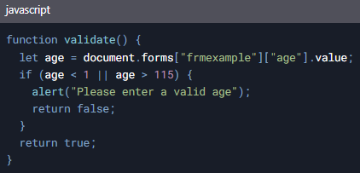
Inline JavaScript Validation
Inline JavaScript with onsubmit:
Example of validate() function:

Slide 9
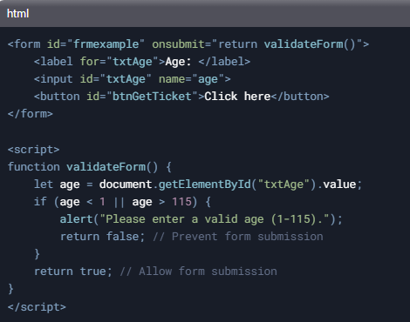
Inline JavaScript Validation
Inline JavaScript with onsubmit:

Slide 10
Summary
HTML forms are essential for user input
HTML5 provides built-in validation, but JavaScript is still necessary for complex validation.
Use e.preventDefault() to stop invalid form submissions.
Inline JavaScript can be used for quick validation.

